Slide 1
GPT-2
IAC Deep Learning Course

Slide 2
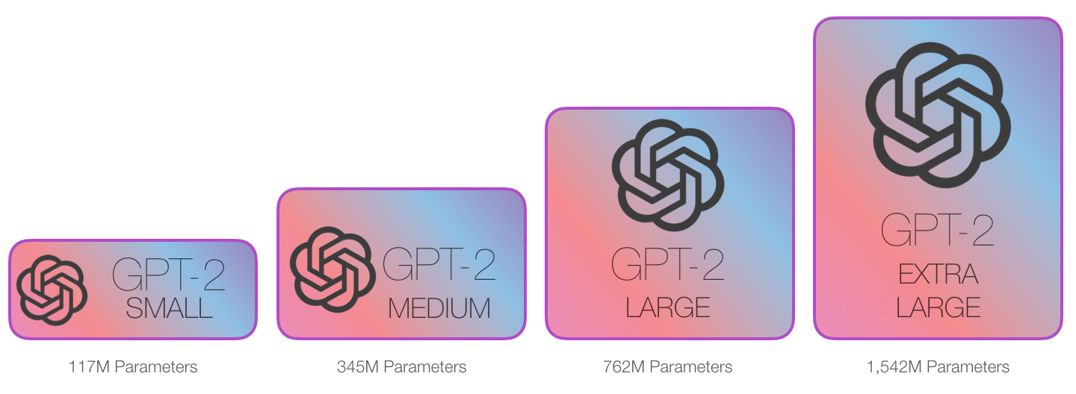
GPT - 2 [https://github.com/openai/gpt-2]
Decoder only Architecture
Trained on 40GB text data
Dataset: WebText

Slide 3
Papers
GPT-1
GPT-2

Slide 4
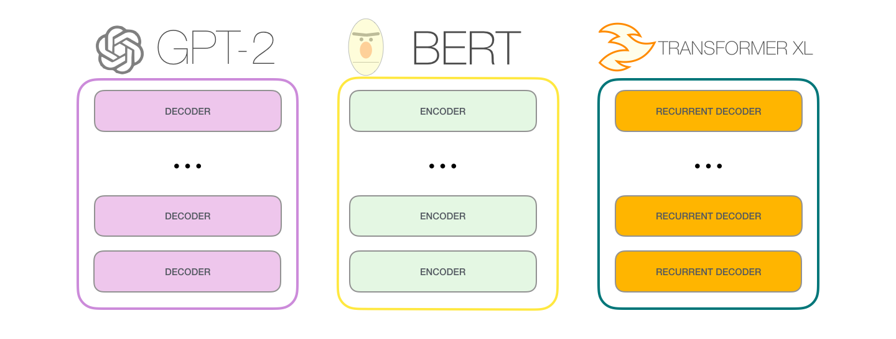
Comparison

Slide 5
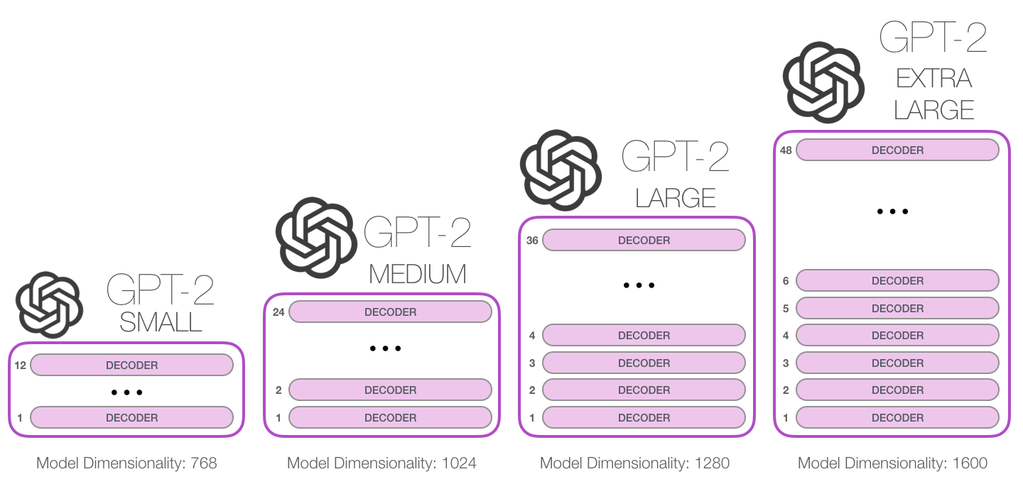
Comparison

Slide 6

GPT 2 Output

Slide 7
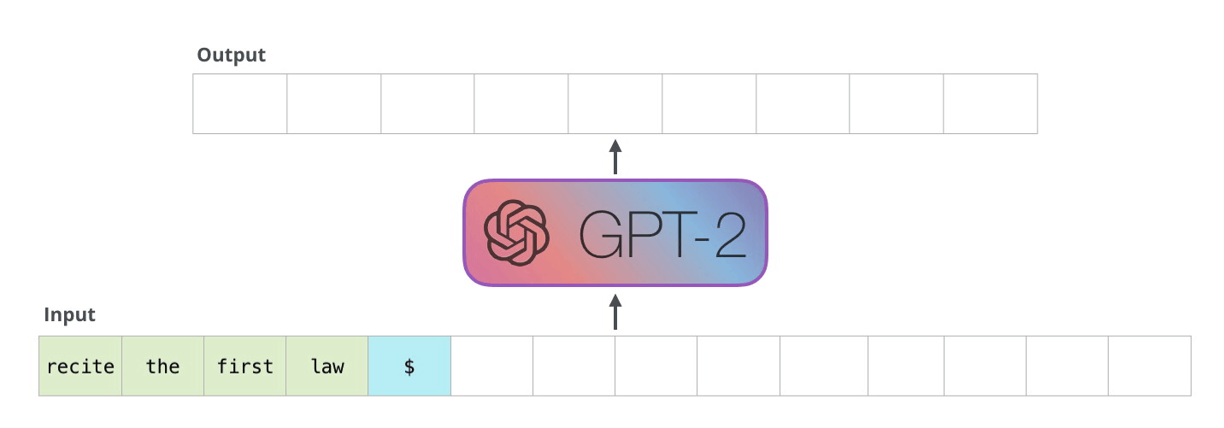
GPT 2 Autoregression

Slide 8
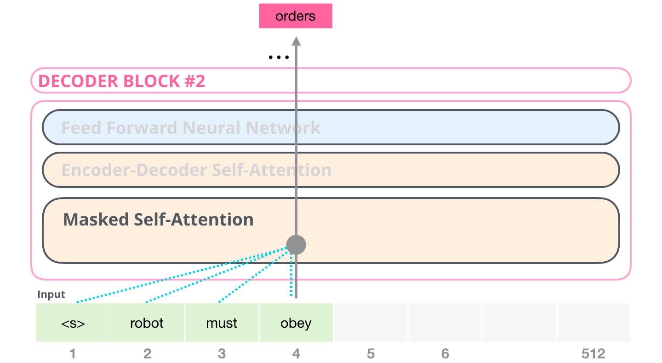
Decoder’s Masked Self Attention

Slide 9
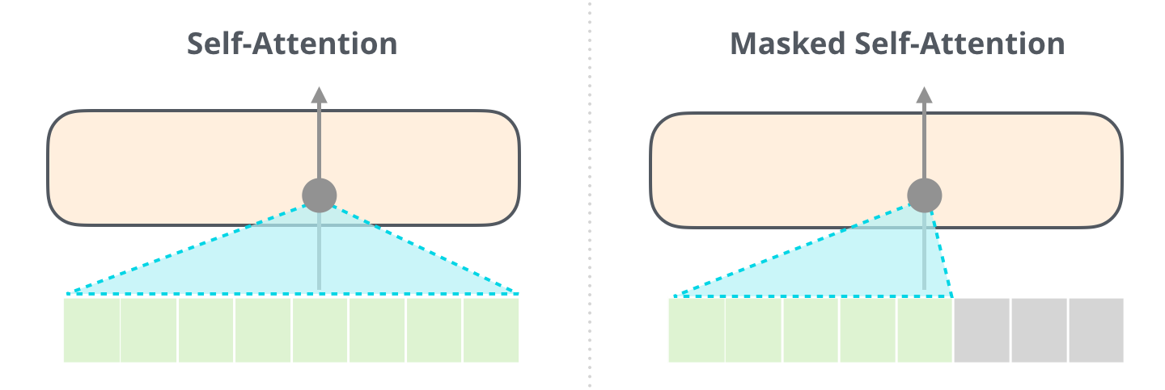
Decoder’s Masked Self Attention

Slide 10
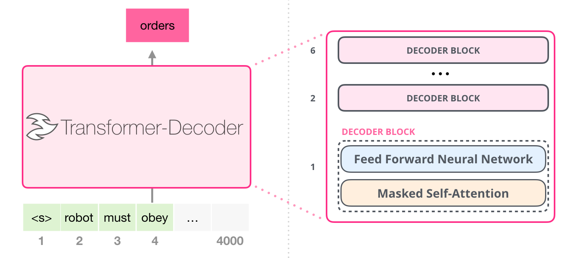
The primary GPT model (GPT-1)

Slide 11
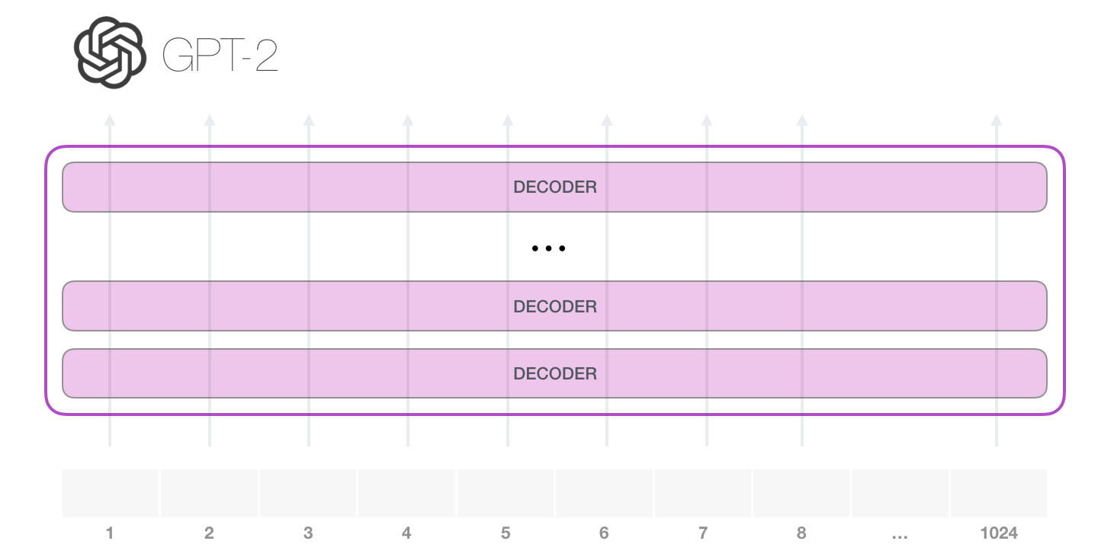
GPT 2

Slide 12
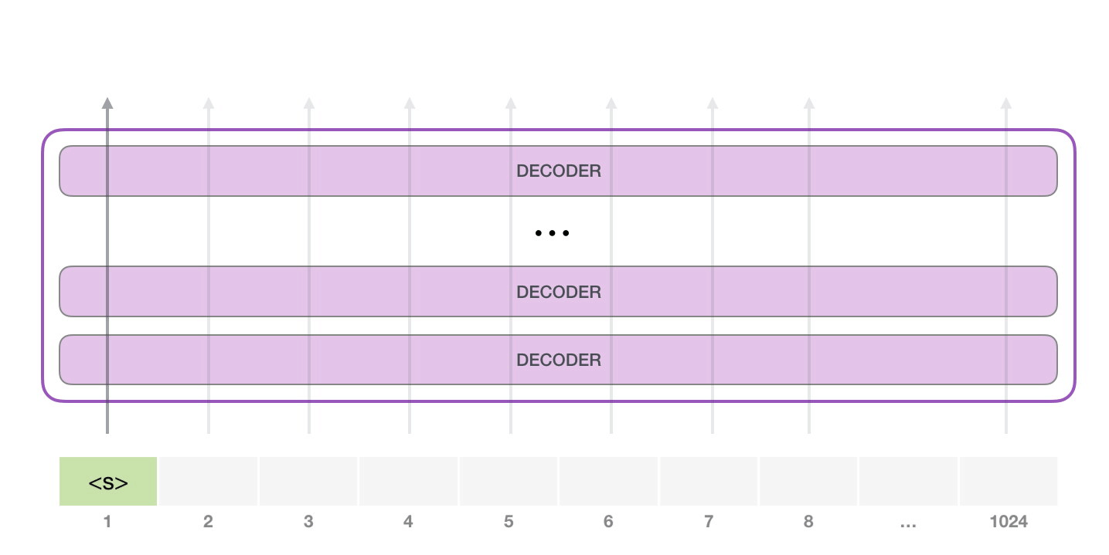
GPT 2

Slide 13
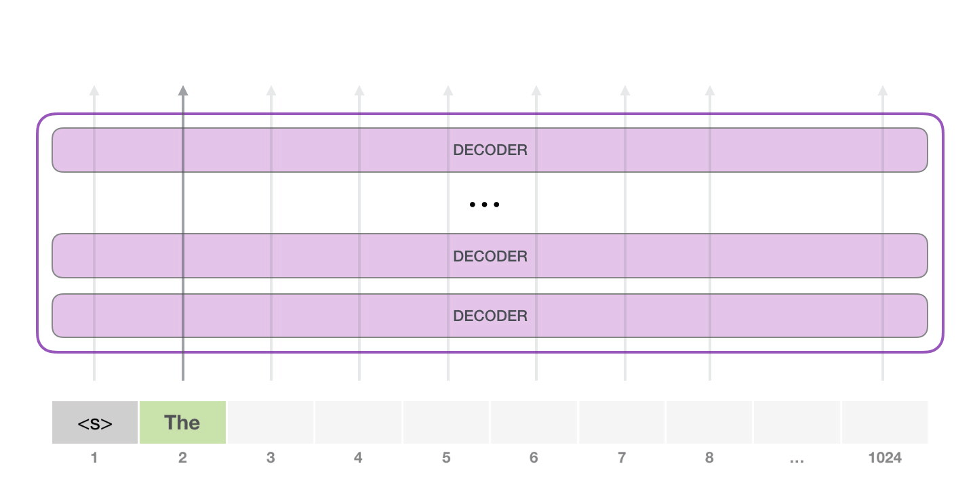
GPT 2

Slide 14
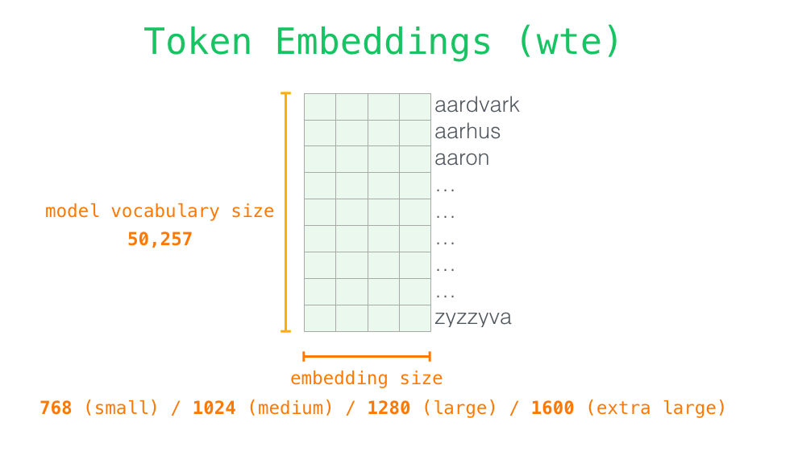
Word Embedding Recap

Slide 15
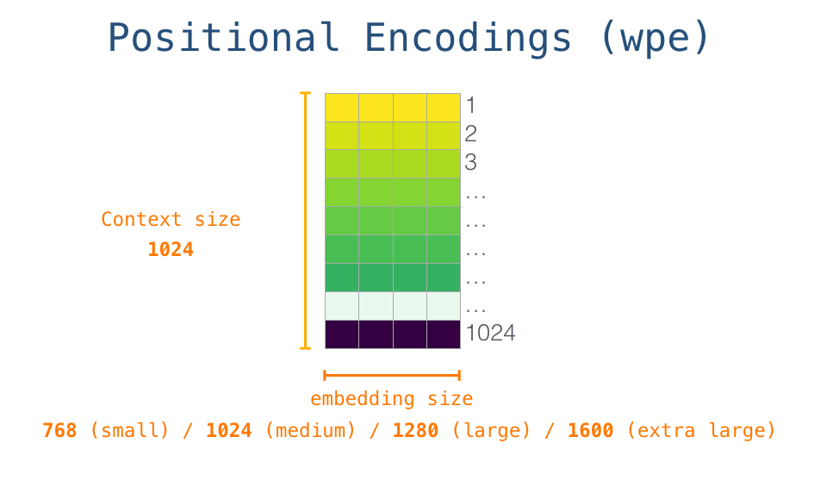
Positional Embedding Recap

Slide 16
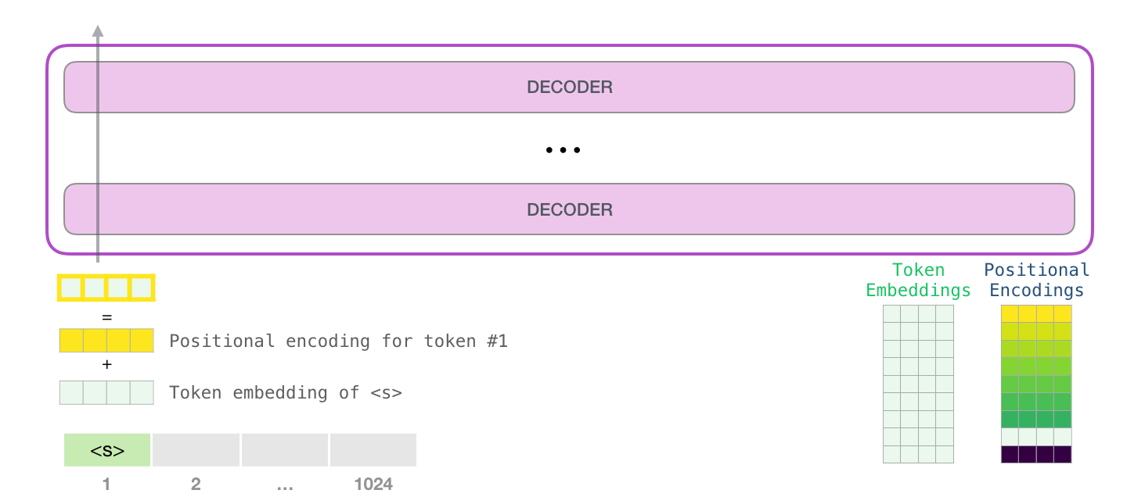
GPT 2 : Model’s Input

Slide 17
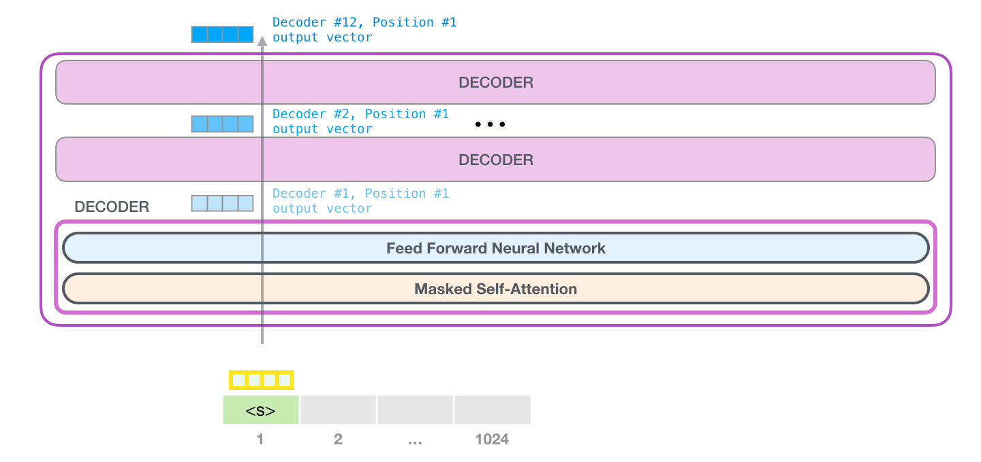
GPT 2

Slide 18
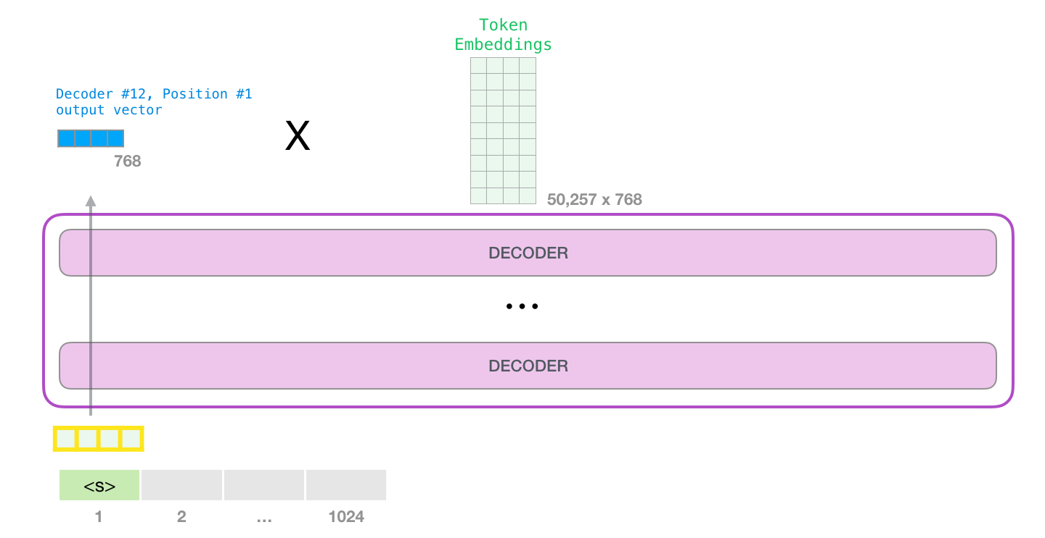
Model Output: There is a change after the last layer!

Slide 19
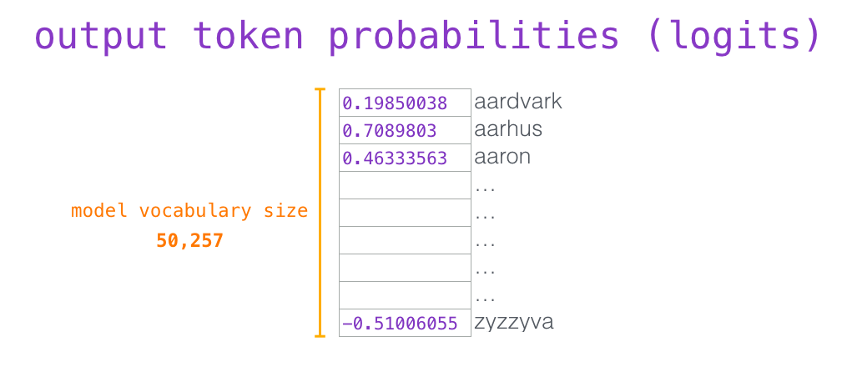
Next Token’s Probability

Slide 20
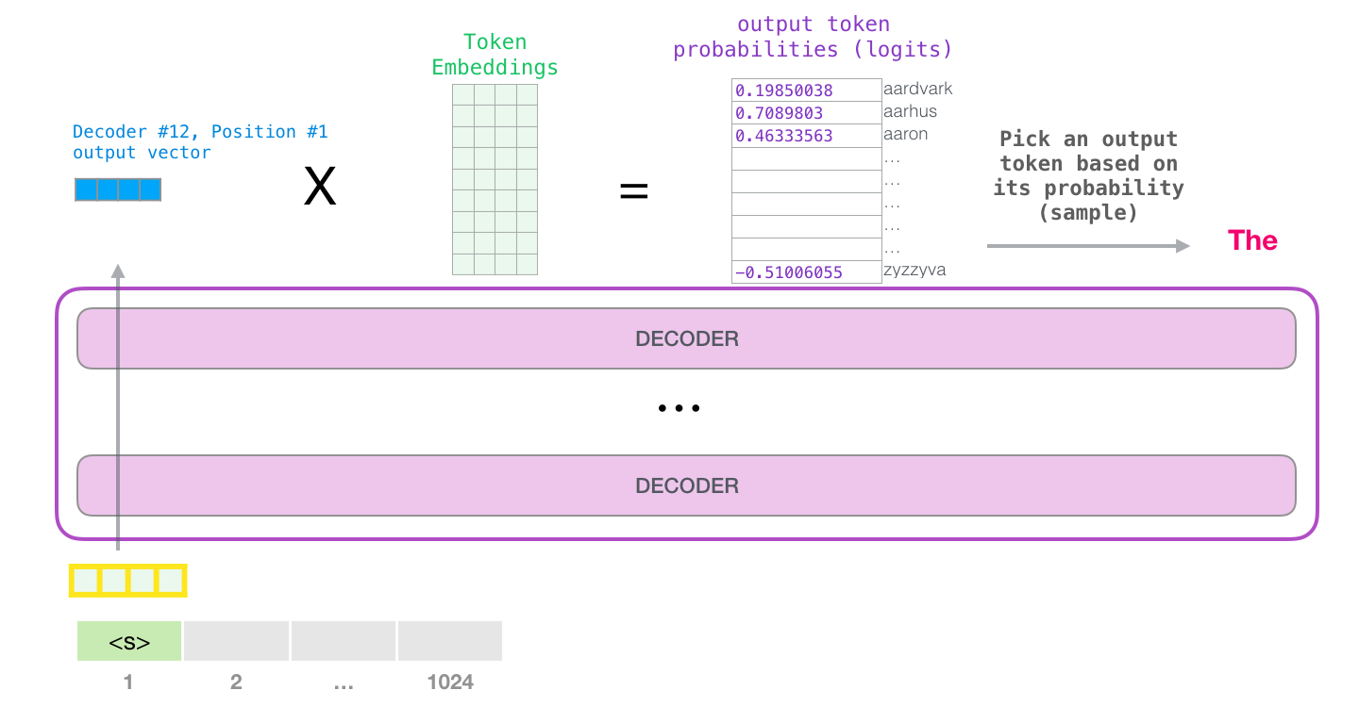
Next Token’s Probability

Slide 21
An Example of Context
Second Law of Robotics
A robot must obey the orders given it by human beings except where such orders would conflict with the First Law.
it refers to the robot
such orders refers to the earlier part of the law, namely “the orders given it by human beings”
The First Law refers to the entire First Law

Slide 22
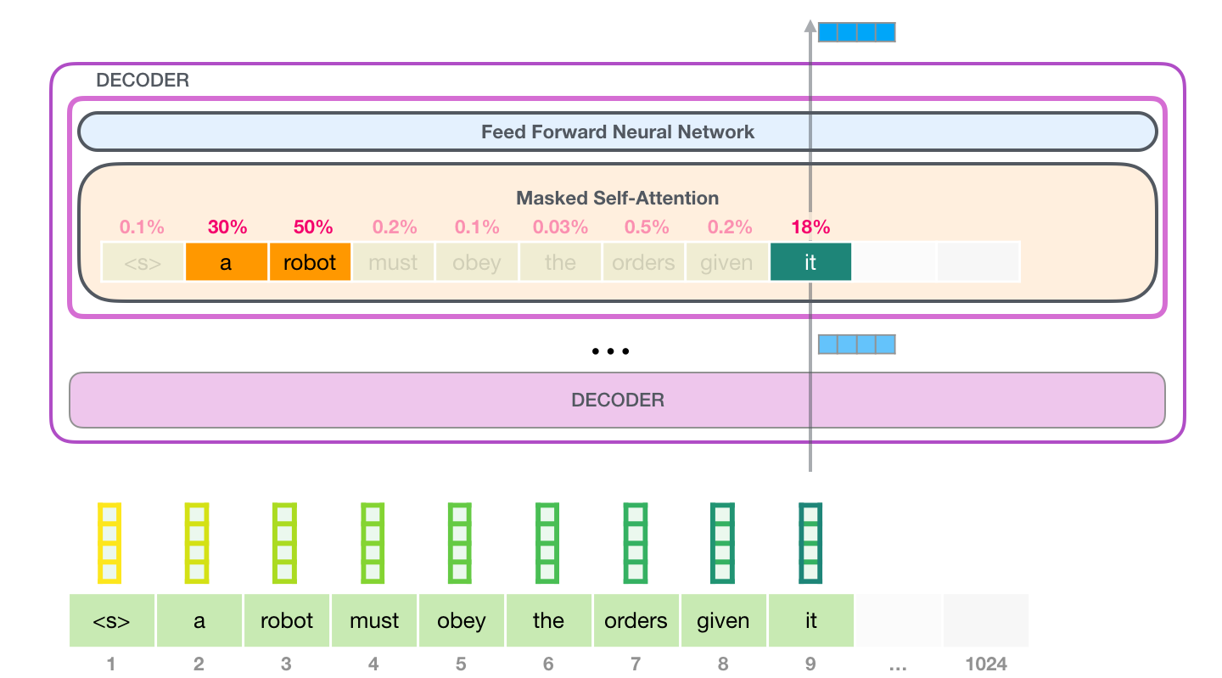
Self Attention Recap

Slide 23
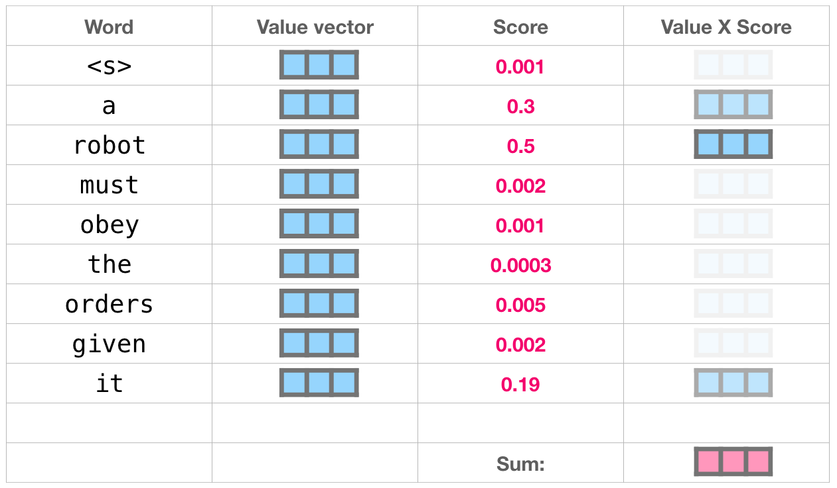
Self Attention Recap

Slide 24
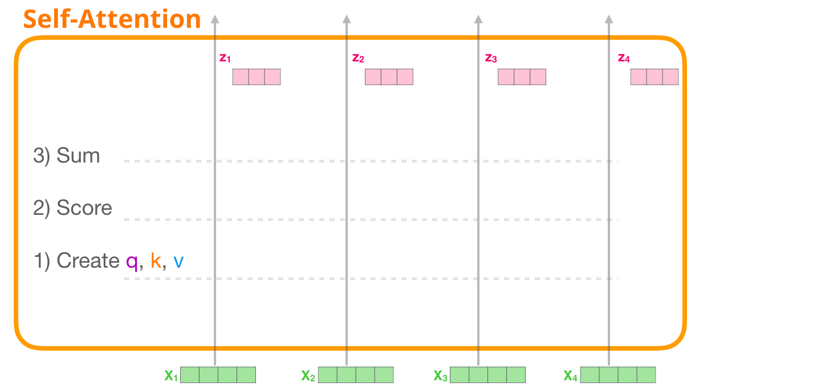
Self Attention Recap

Slide 25
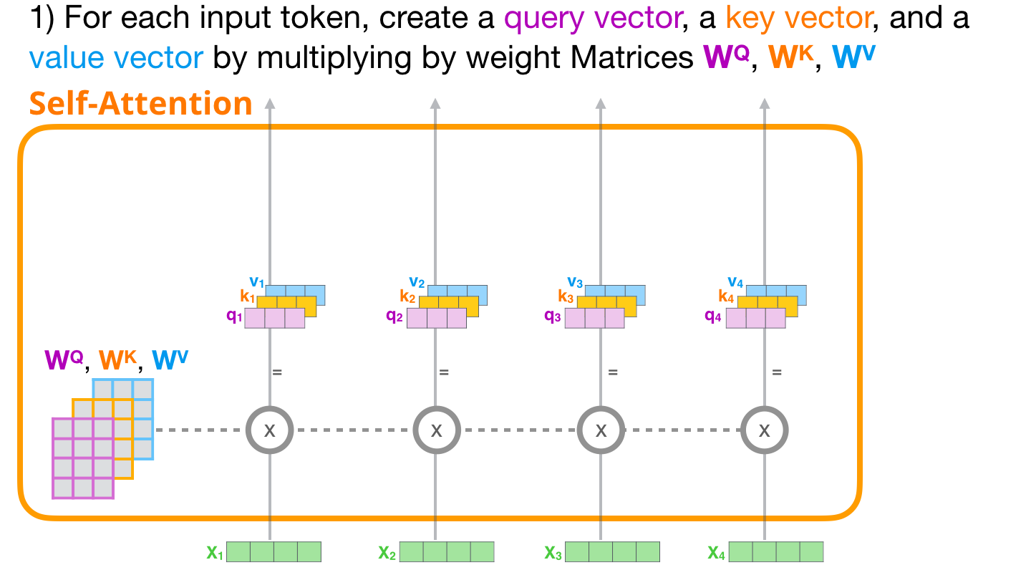
Self Attention Recap

Slide 26
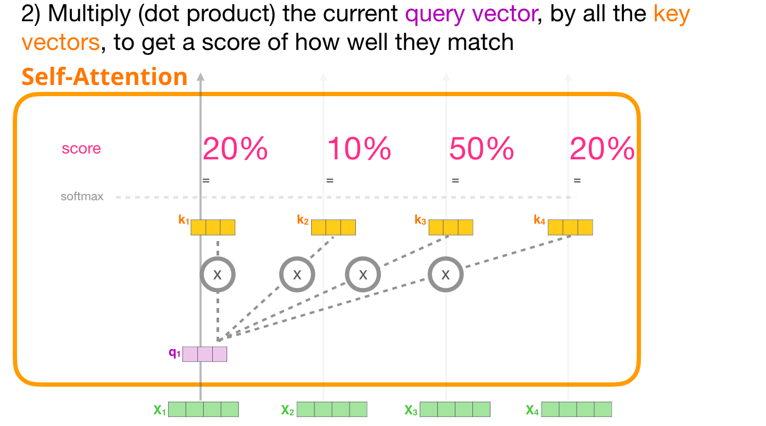
Self Attention Recap

Slide 27
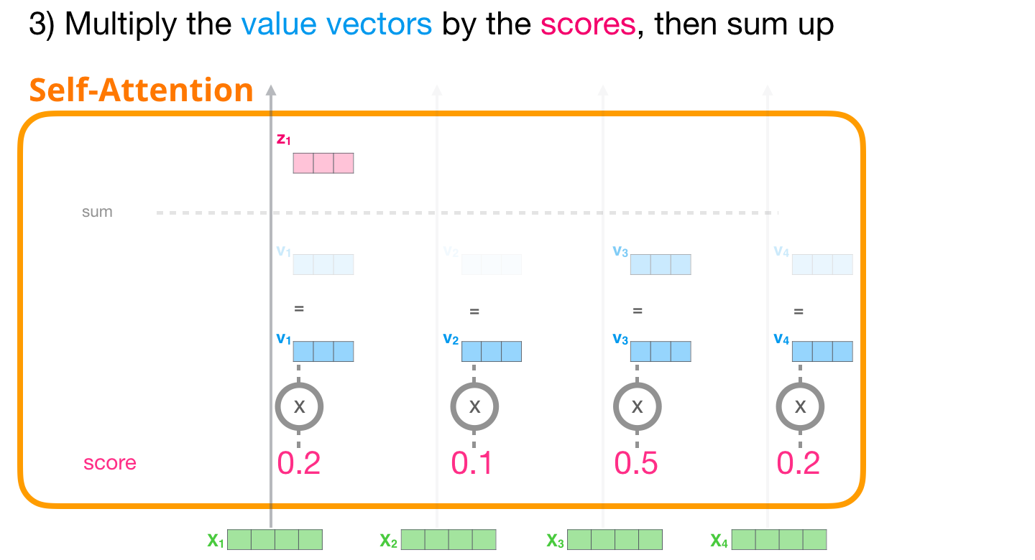
Self Attention Recap

Slide 28
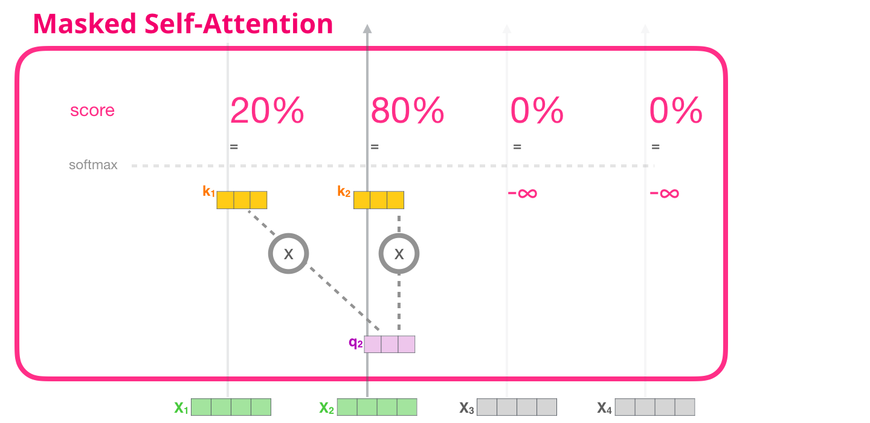
Masked Self Attention

Slide 29
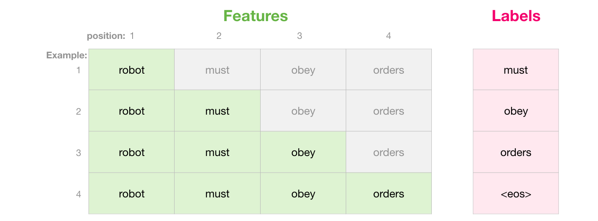
Masked Self Attention

Slide 30
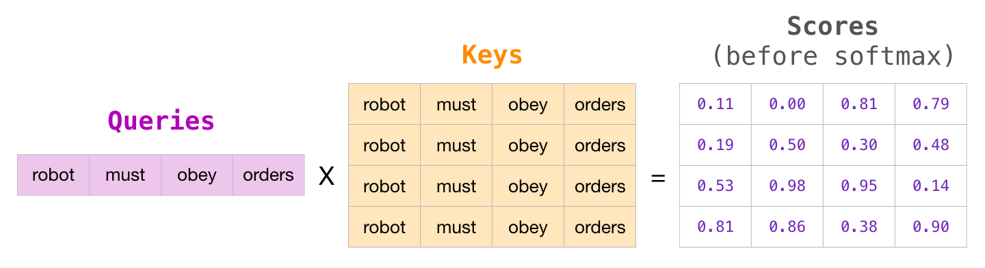
Masked Self Attention

Slide 31
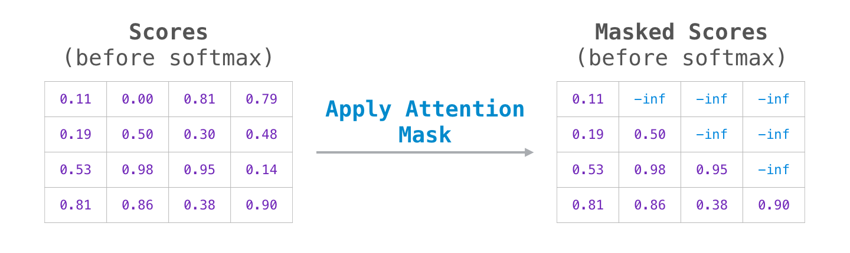
Masked Self Attention

Slide 32
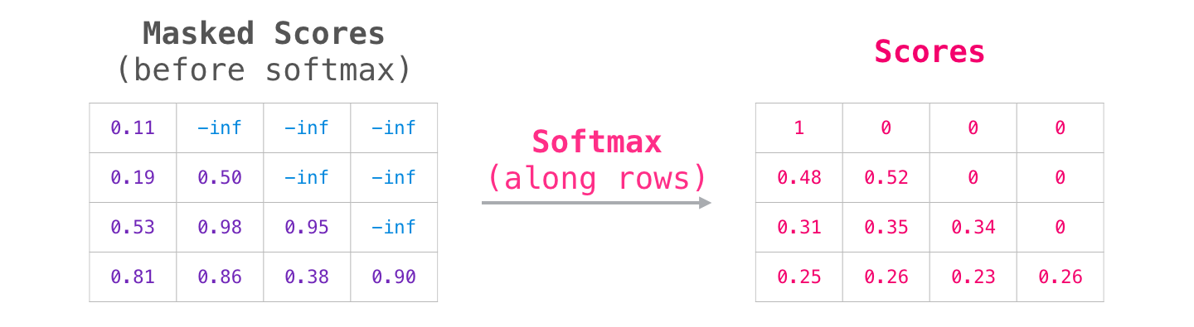
Masked Self Attention

Slide 33
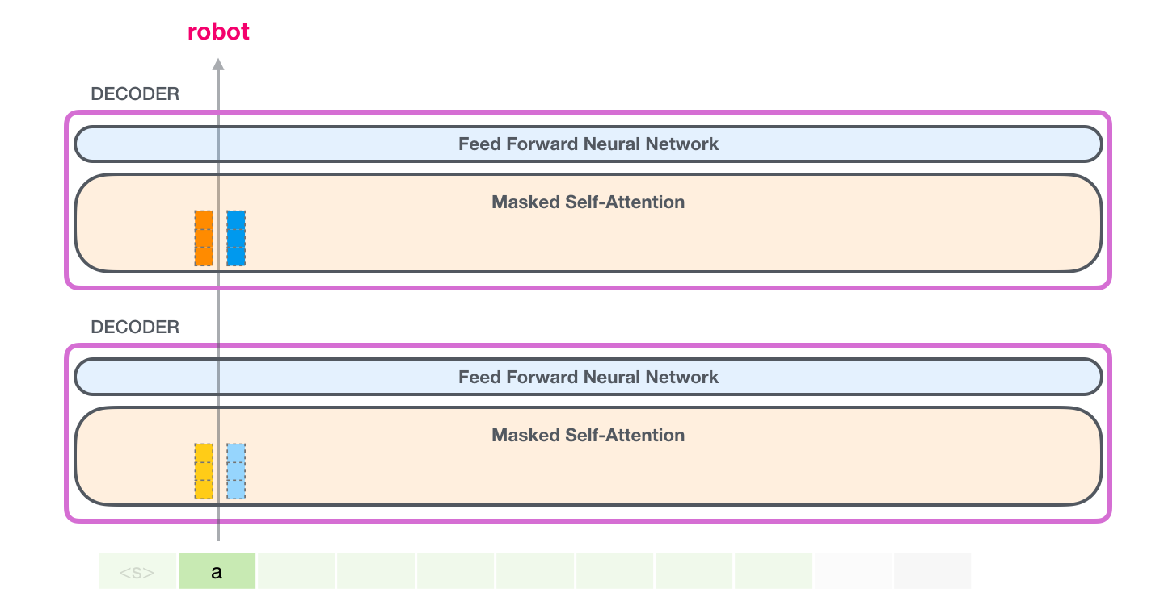
GPT 2: Eval Mode (Caching Key Value )

Slide 34
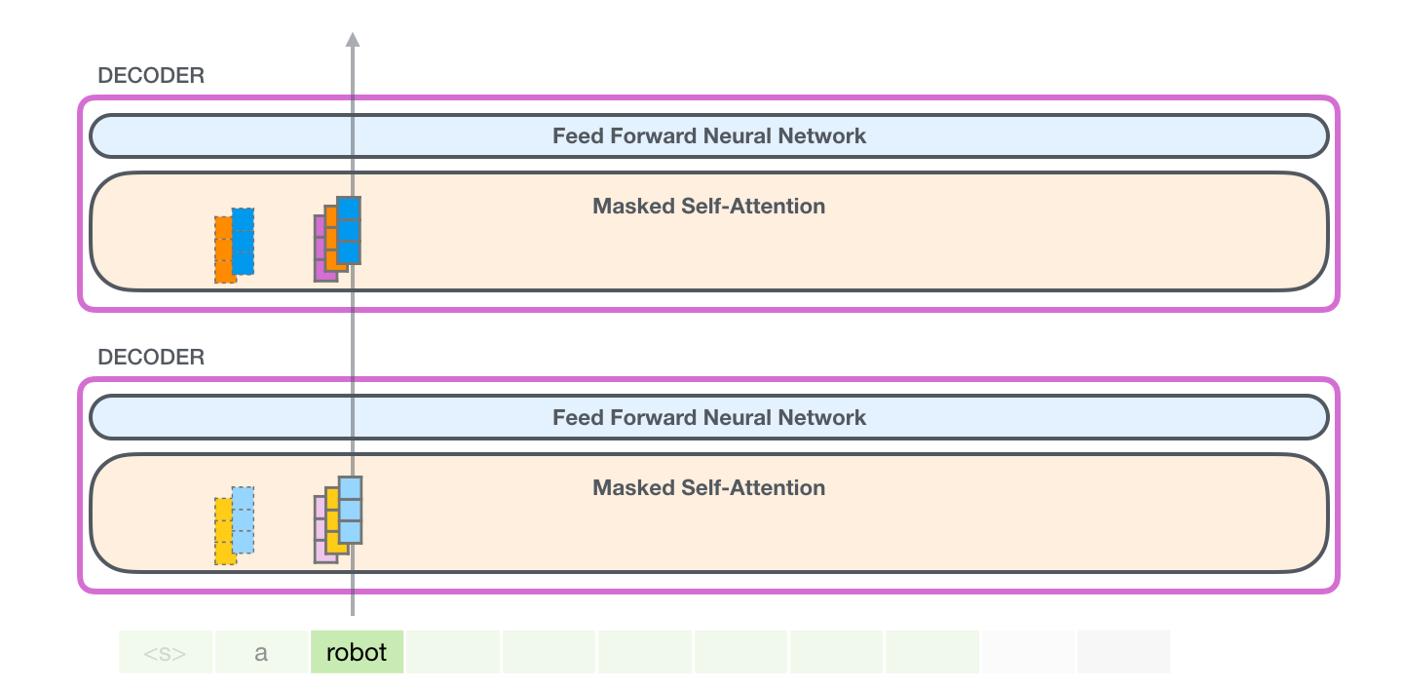
GPT 2: Eval Mode (Caching Key Value )

Slide 35
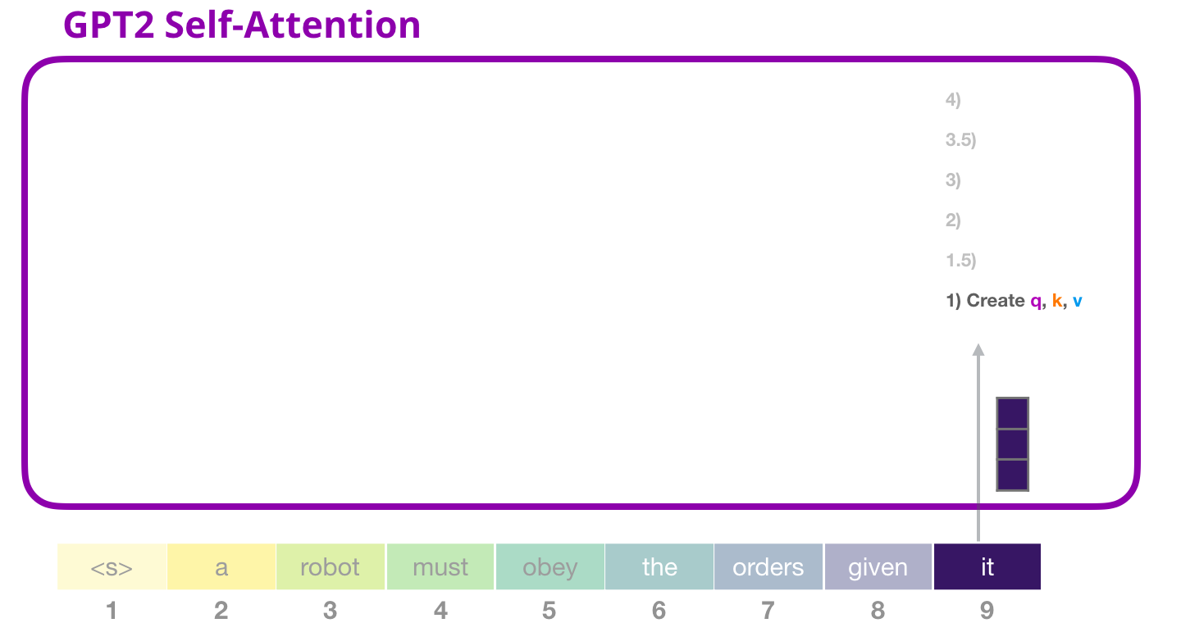
GPT 2: Input the token it

Slide 36
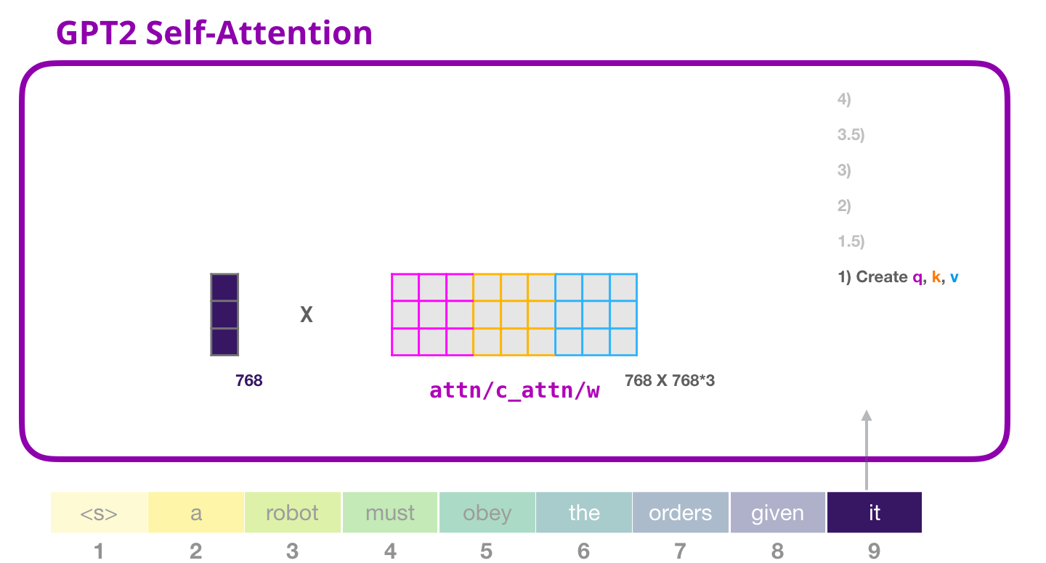
GPT 2: Key Value Query Generation

Slide 37
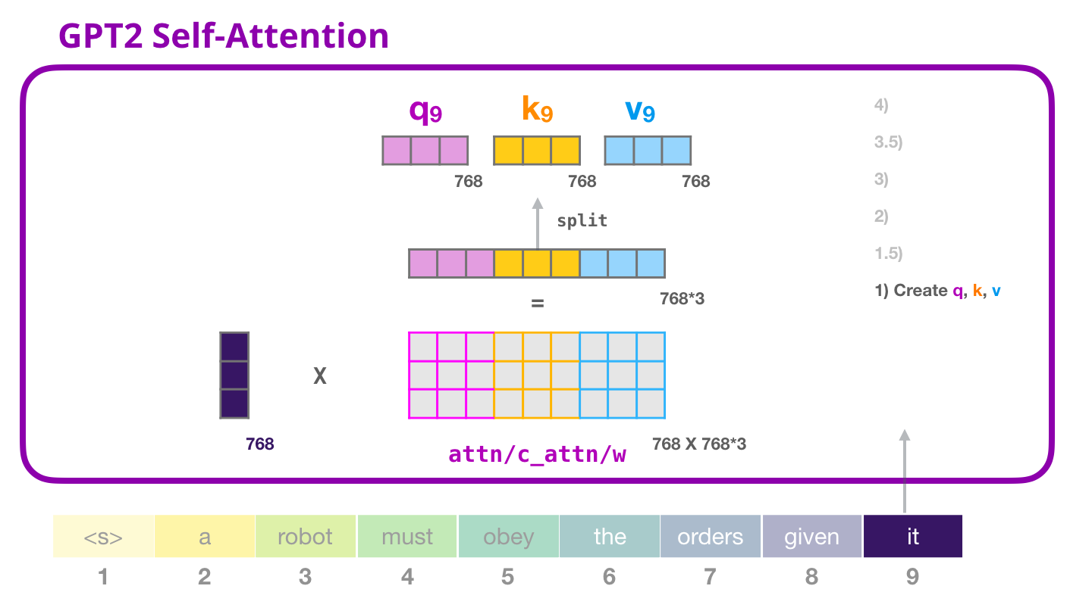
GPT 2: Q K V

Slide 38
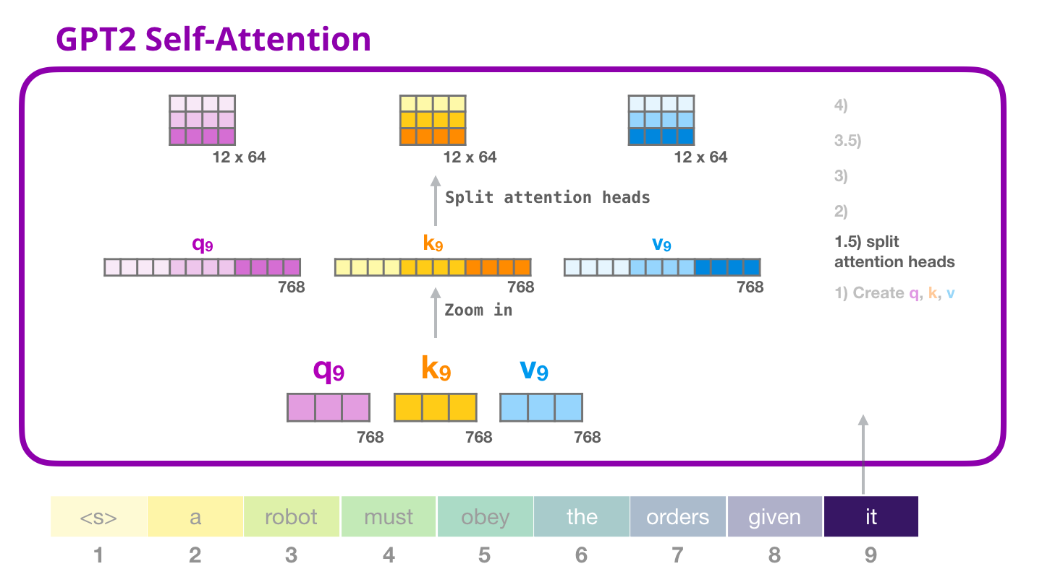
GPT 2: Multi Head

Slide 39
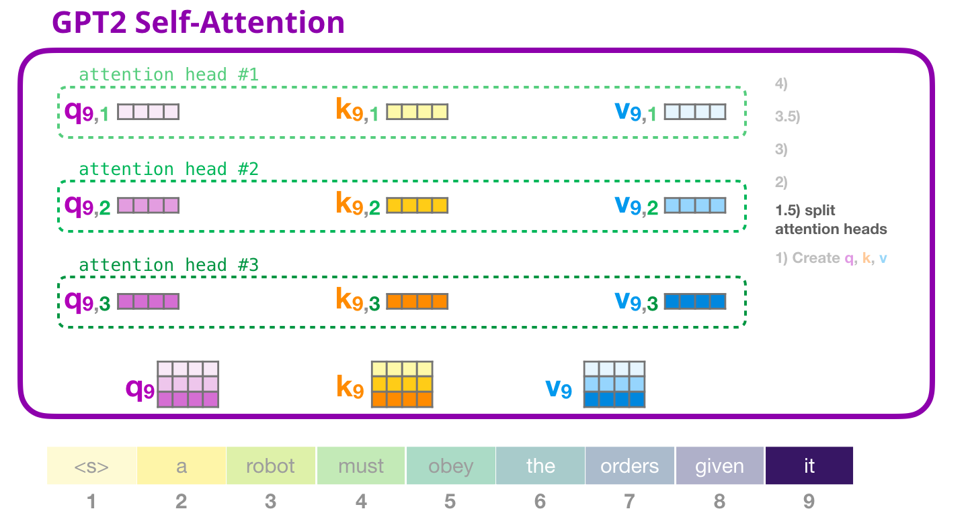
GPT 2: Multi Head

Slide 40
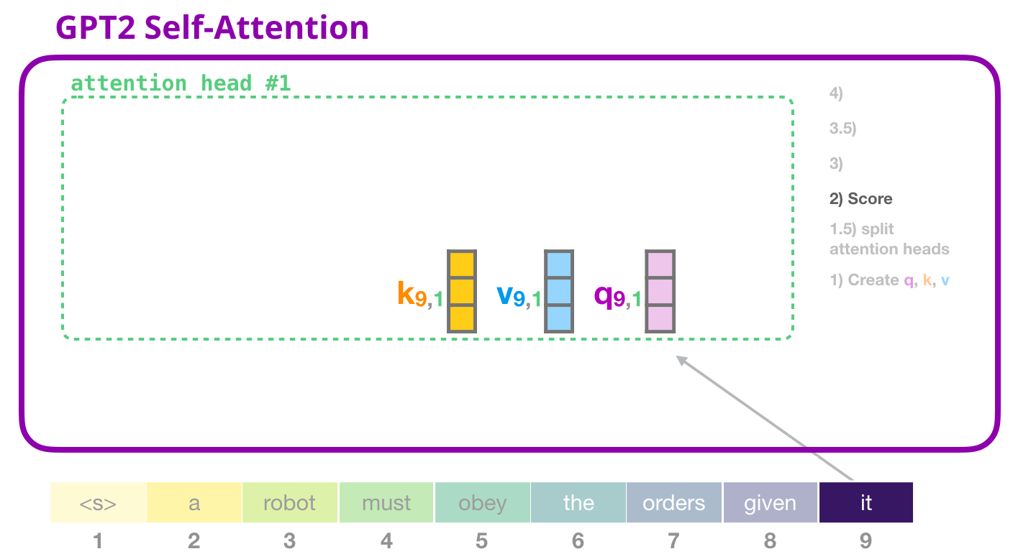
GPT 2: Zooming into a Head

Slide 41
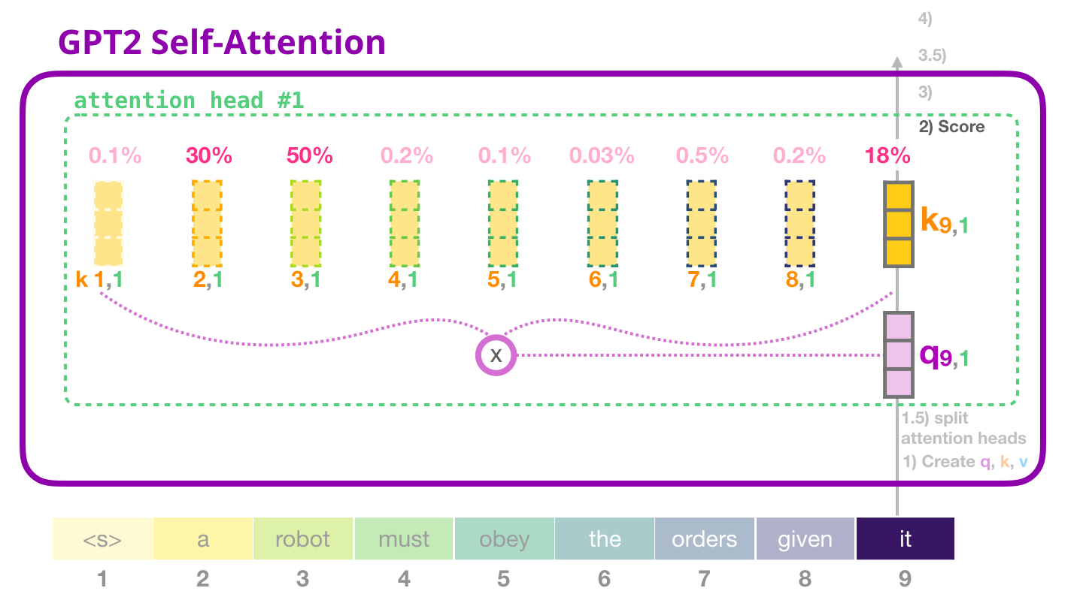
GPT 2: Eval Mode (Caching Key Value )

Slide 42
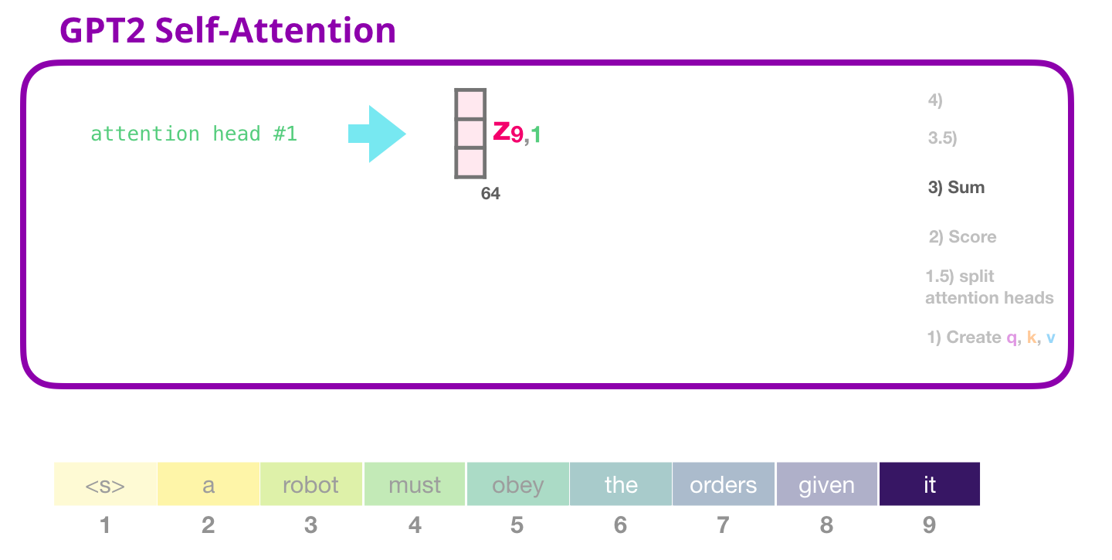
GPT 2: Concating the heads

Slide 43
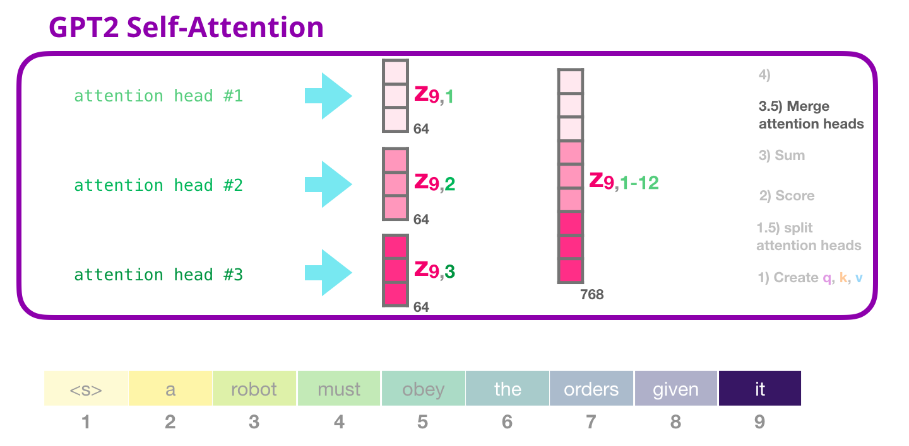
GPT 2: Concating the heads

Slide 44
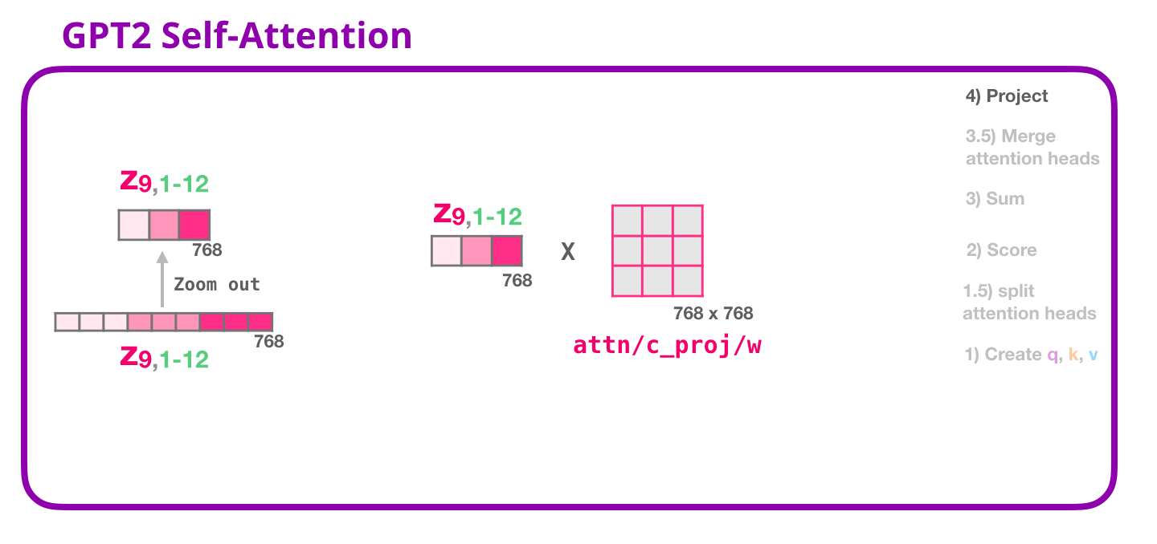
GPT 2: Projection

Slide 45
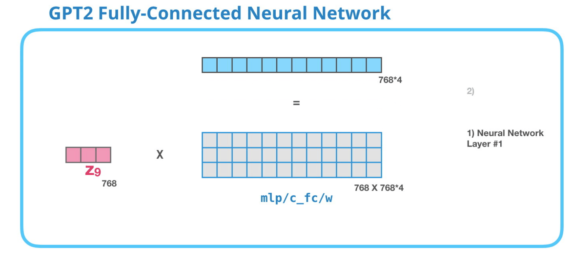
GPT 2: FFN

Slide 46
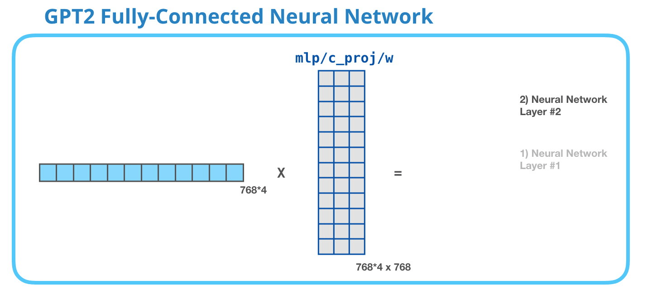
GPT 2: FFN

Slide 47
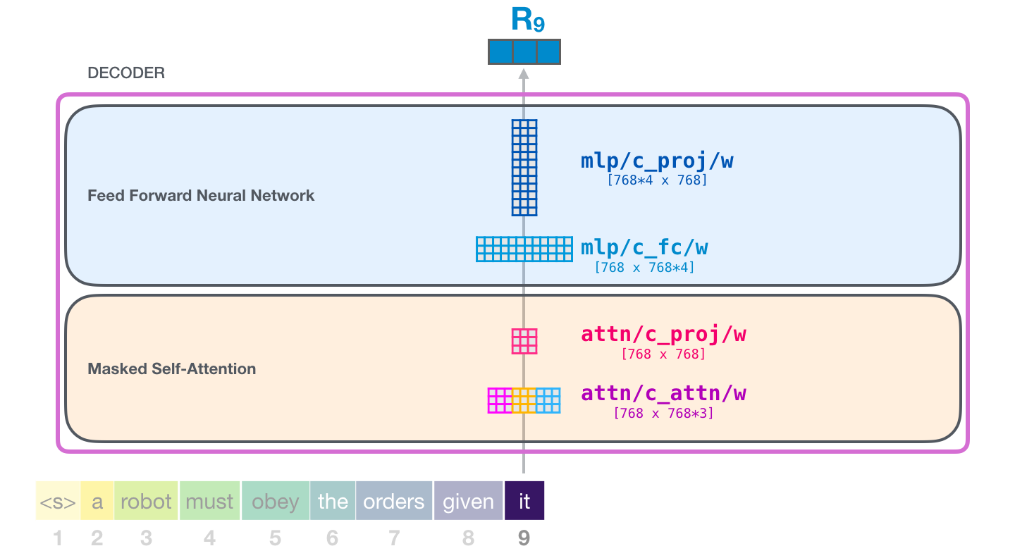
GPT 2: Full Architecture

Slide 48
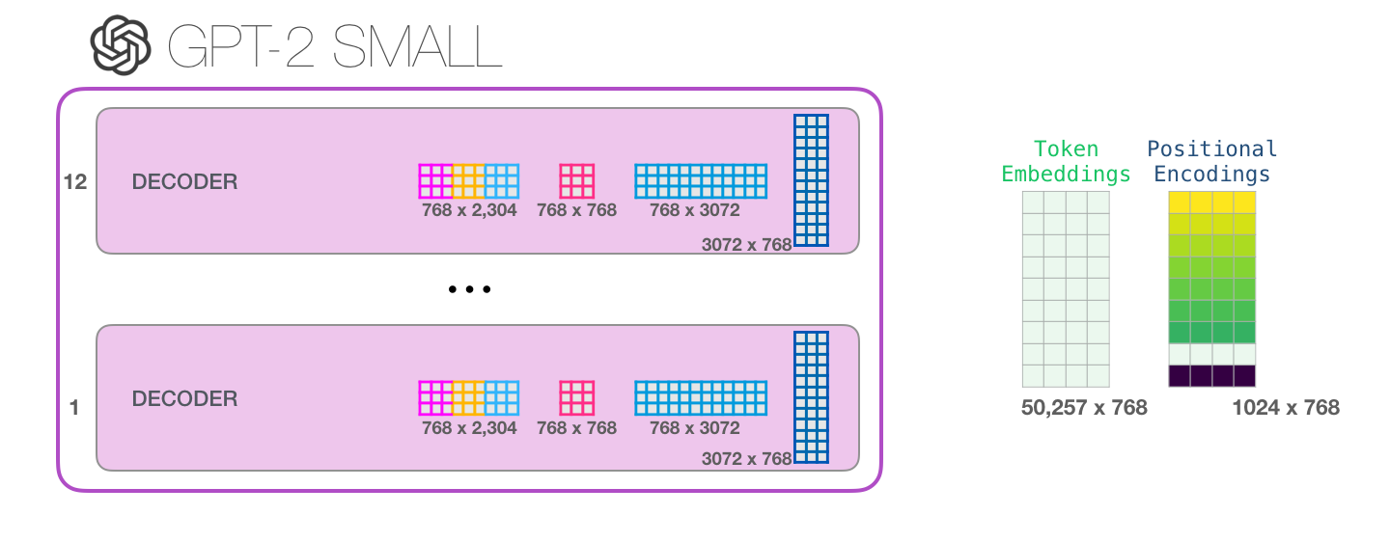
GPT 2: Full Architecture

Slide 49
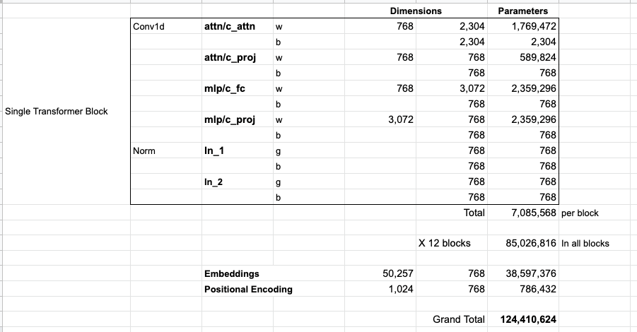
GPT 2: Parameter Count

Slide 50
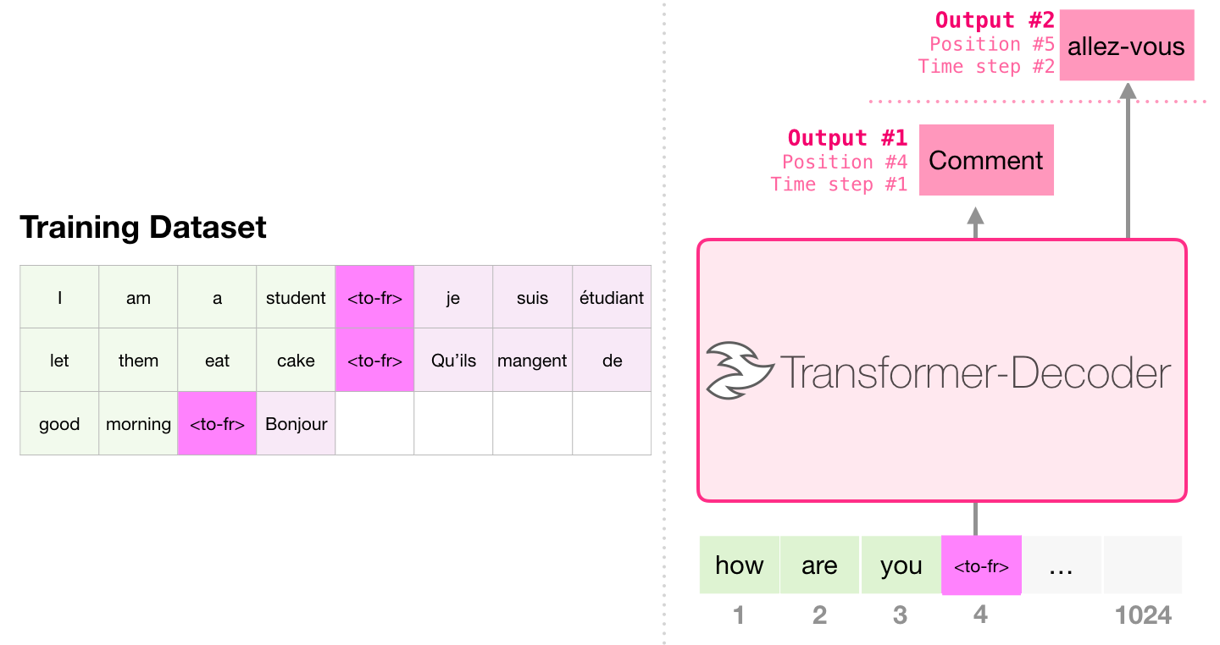
Translation with GPT 2

Slide 51
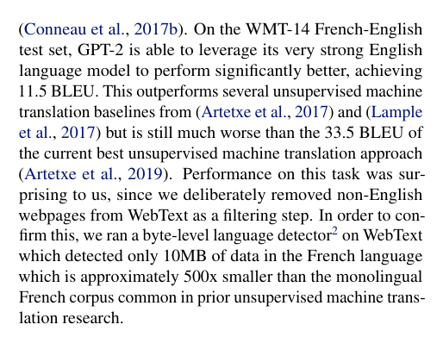
Translation with GPT 2

Slide 52
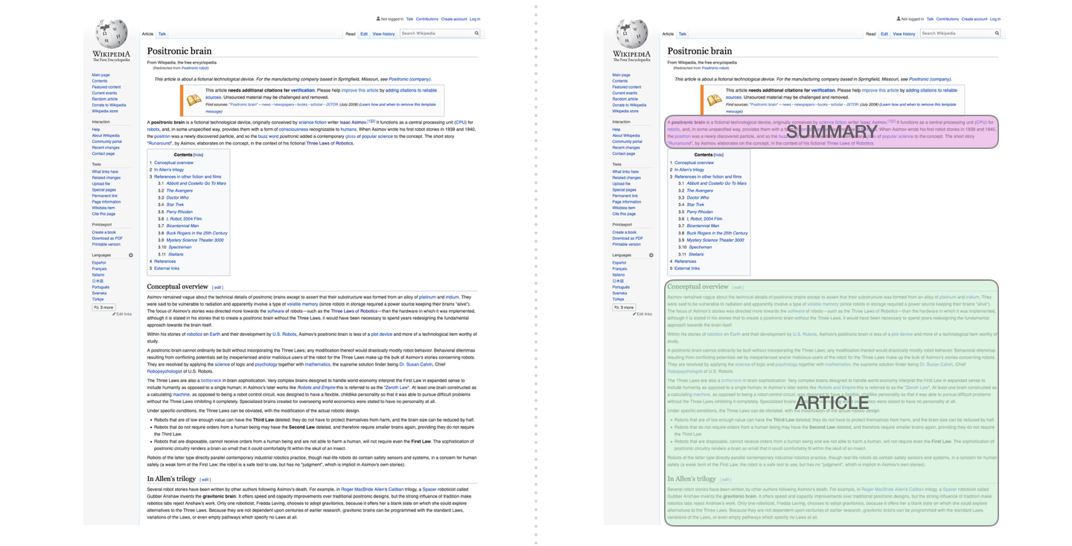
Related Works: Wiki Summerziation

Slide 53
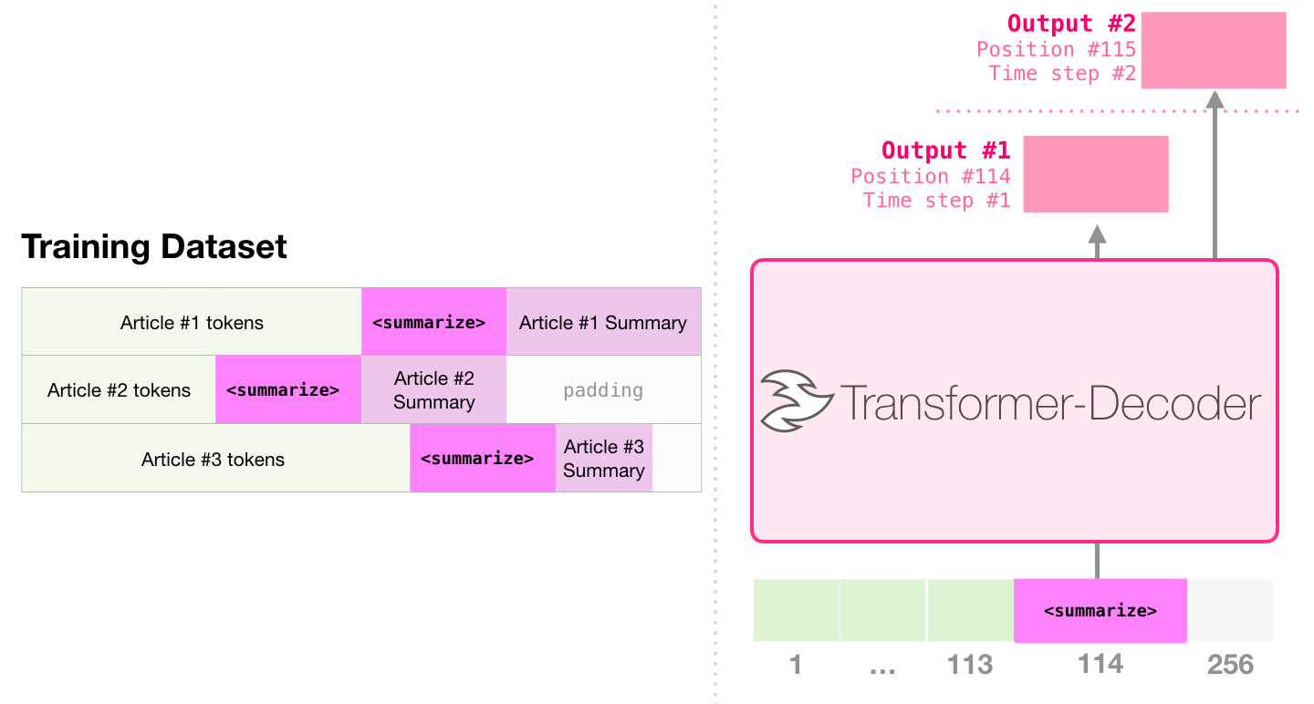
Related Works: Wiki Summerziation

